Slide 1
GHPField
Builder POs and crew work
in one place
For mailbox, fireplace and address-plate installers
ghpfield.com
Notes:
GHPField sales introduction. Product description is based on the existing GHPField workflow. Audience: specialty installers coordinating home-builder purchase orders and homeowner work. No customer outcome or third-party benchmark is claimed. Website: https://ghpfield.com.

Slide 2
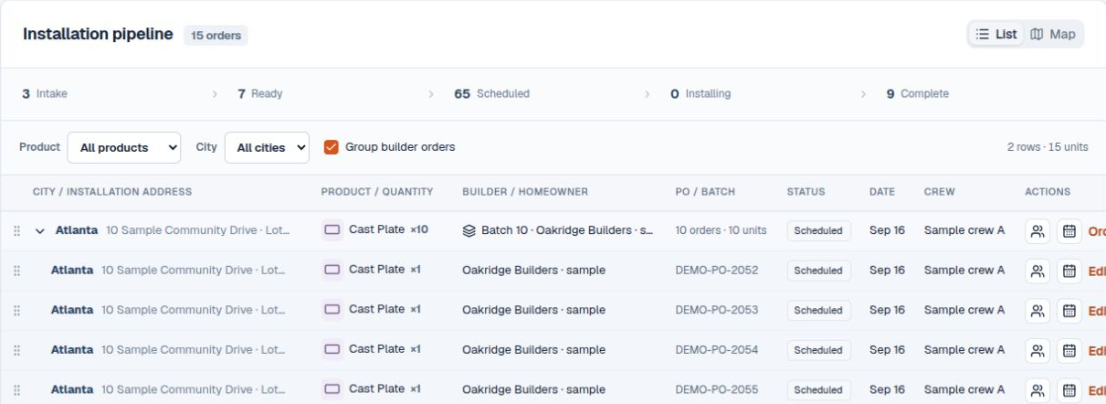
Every PO keeps its details
Plan related work together. Keep each PO separate.
Demonstration data. Customer, products, location and instructions stay with each order.
Notes:
Source: existing GHPField application, work/training/shots/03-expanded.png. All displayed records are fictional sample data. Related work is grouped using supported builder/location/day rules and individual PO records remain separate. Customer, community, product and site detail are available per order. A saved community entrance is separate from the exact lot or installation address.

Slide 3
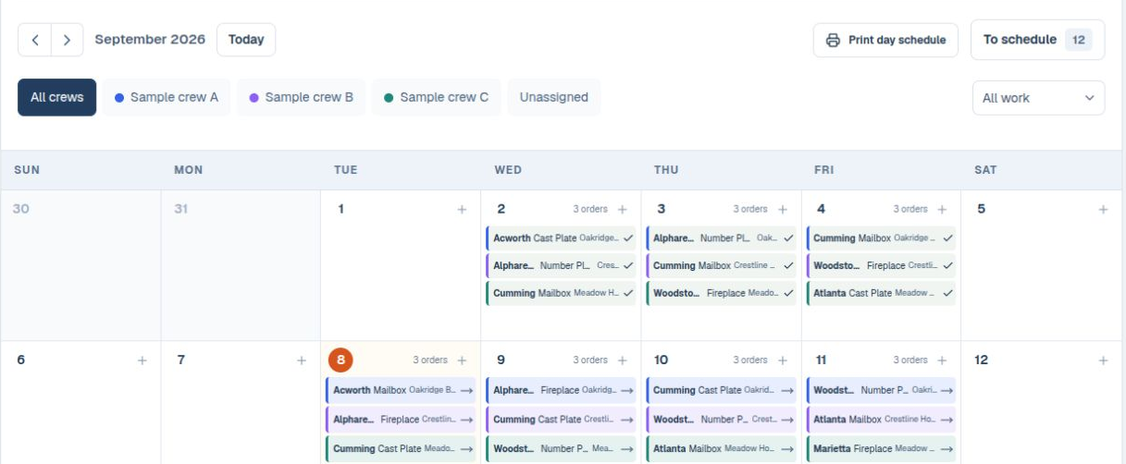
A clearer crew day
Assign crews. Adjust dates. Review the schedule.
Month view detail with fictional orders. Printed day schedules are also available.
Notes:
Source: existing GHPField application, work/training-v2/shots/05-month.png. All displayed records are fictional demonstration data. This crop shows part of the month view, not the full month. Crew assignment and date changes remain subject to job readiness and user permissions. The application also supports a printed daily schedule.

Slide 4
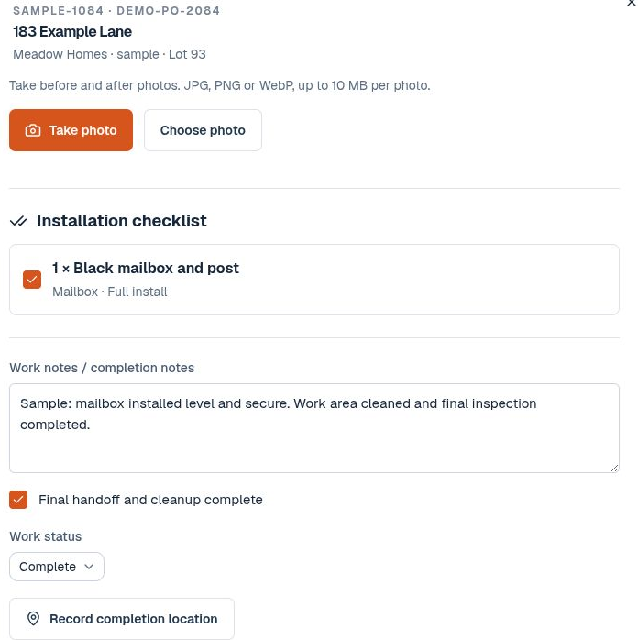
Explore the free demo
Open an order.
Review the schedule.
Follow the crew workflow.
ghpfield.com
Crew workspace. Demonstration data.
Notes:
Source: existing GHPField application, work/training/shots/07-phone-checklist.png. The image is a desktop capture of the crew workspace, not a native iPhone or Android screen recording. All records and installer labels are fictional. Photo, checklist, note and completion controls are shown. Mobile access uses the supported installable online web app. Location requires permission and is not continuous background tracking. Explore the demo at https://ghpfield.com.

Slide 5
A guided trial
1. Review your workflow
and setup
14 days
2. Confirm a small trial
with your team
No card required
3. Evaluate it before
choosing paid service
Trial requests are reviewed before activation.
Notes:
Offer instructions supplied for this presentation: request a guided 14-day trial, no card required, with company fit and setup reviewed before the trial is confirmed. A request does not automatically provision a company workspace or activate service. Trial scope and start date must be confirmed. Continuing into paid service requires the customer’s explicit approval. Website: https://ghpfield.com.

Slide 6
Core plan
$99
Up to 5 crews
and 10 users
per company per month
Integrations and provider services are additional.
Availability is confirmed individually.
Explore the demo or request a guided trial
ghpfield.com
Notes:
Commercial source: owner-approved GHPField offer, confirmed 2026-09-08. The Core plan is $99 per company per month for up to 5 crews and 10 users. This price is supplied by the owner, not a competitor benchmark. The customer must approve the paid plan and terms before paid service begins. Accounting, builder portal, payments, AI and communication/provider services require individual review, may have additional charges, and are not all connected today. The guided 14-day trial requires setup review before activation and no card is required. The owner selected Google Workspace for sales@ghpfield.com and support@ghpfield.com, but these mailboxes have not been created and are not represented as active; the public CTA is https://ghpfield.com.

